Slide 1
COM506 Computer Design
Lecture 0. Course Introduction
Prof. Taeweon Suh
Computer Science Education
Korea University

Slide 2
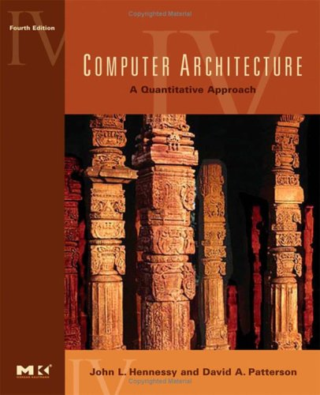
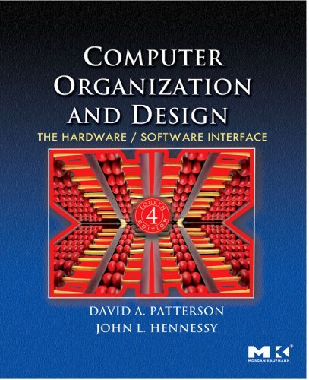
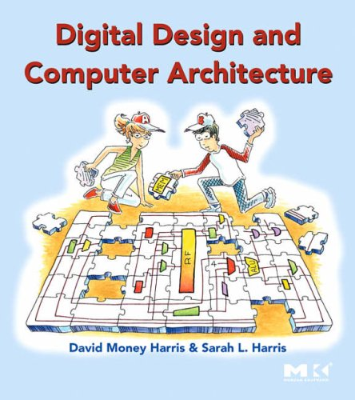
Course Information
Instructor
Prof. Taeweon Suh
References
Digital Design and Computer Architecture by David Money Harris and Sarah L. Harris, Morgan Kaufmann, 2007
Computer Organization and Design by David Patterson and John Hennessy, 4th Ed., Morgan Kaufmann, 2009 (No Korean-translated version)
Computer Architecture: A Quantitative Approach (Fourth Edition) by John L. Hennessy and David A. Patterson, 2007, Morgan Kaufmann
Web materials at http://www.adc.co.kr
Prerequisites
COMP212 Computer Architecture
COMP211 Computer Logic Design
C language
Verilog-HDL
Office hours
After class as needed
By appointment at Lyceum 307
Contact Information
suhtw@korea.ac.kr
02-3290-2397
Class web page
http://esca.korea.ac.kr/

Slide 3
Undergrad-level Computer Architecture
Topics covered include the followings
RISC ISA (Instruction Set Architecture)
MIPS, ARM
In-order microarchitecture
Single-cycle MIPS
Pipelined (5-stage) MIPS
Memory hierarchy
Registers, caches, main memory, and HDD
Virtual memory
TLB (Translation Lookaside Buffer)
http://www.mips.com/
http://www.arm.com/

Slide 4
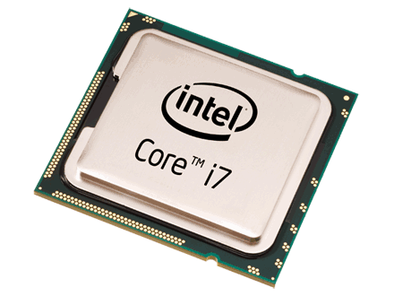
Graduate-level Computer Architecture
Topics include the state-of-art technologies to increase performance in modern computers
Out-of-order microarchitecture
ILP (Instruction-level Parallelism)
Limits on ILP
TLP (Thread-level Parallelism)
Multi-core and multiprocessors
Cache coherence protocols
Advanced topics in memory hierarchy

Slide 5
COM506 Computer Design
Gain practical knowledge of CPU design
Experiment with Lucida
32-bit 5-stage RISC processor
16-bit instructions (like Thumb mode in ARM)
Adchips calls it an EISC (Expandable Instruction Set Computer) architecture
http://www.adc.co.kr
Analysis of CPU source code written in Verilog-HDL
Simulation & FPGA-based emulation
Lucida RTL change and verification for performance improvement
Branch predictor
Instruction queue w/ multi-cycle cache access
Load/store queue

Slide 6
COM506 Computer Design (Cont)
Seminar & Discussion-based
Not a lecture-based course
Environment & Tools
Windows or Linux-based
Simulations: ModelSim-XE (Xilinx Edition), ISE, Verilog-XL(?)
Emulation: Virtex-5 or Virtex-6

Slide 7
Grading Policy
No exams
RTL Analysis & Presentation: 30%
Term Project: 50%
Branch predictor (?) RTL coding & Validation
Active Class Participation: 20%

