Slide 1
Speculative Return Address Stack Management Revisited

Slide 2
Paper Intro
ACM Transactions on Architecture and Code Optimization (TACO)
Volume 5 Issue 3, Nov 2008
Author:
Hans Vandierendonck Ghent University, Gent, Belgium
André Seznec IRISA/INRIA, Cedex, France

Slide 3
Contents
RAS Intro
Big Picture of RAS
Abstract on Paper
Introduction on Paper
Detecting Overflows and Wrong-Path on Conventional RAS
Simple RAS PUSH
Simple RAS POP
Simple RAS with CD-TOS
CT-RAS Recovery
SC-RAS and Reallocation Detecting
SD-RAS PUSH
SD-RAS POP
SD-RAS Advantage
SD-RAS Disadvantage
SD-RAS with Empty bit
SD-RAS with MAX
Evaluation on Paper

Slide 4
Big Picture of RAS
PC
BTB
RETURN?
4
+
Predicted next PC
Push
Return
Address
Pop
Return
Address
TOS

Slide 5
Abstract on Paper
Present two low-cost corruption detectors for RAS.
They detect RAS overflows and wrong-path corruption.
When corruption is detected, BTB can be used as a free backup predictor.

Slide 6
Introduction on Paper
The RAS is typically implemented as a circular buffer to store return addresses and a top-of-stack pointer (TOS) pointing to the current top of the stack.
The RAS must be updated for speculatively fetched instructions.
When a misprediction is detected, the call instruction may be squashed, leaving the wrong return target on the RAS.

Slide 7
Simple RAS PUSH
TOS
TOS
TOS
TOS
TOS
RAS Overflow

Slide 8
Simple RAS POP
TOS
TOS
TOS
TOS
TOS
RAS Underflow

Slide 9
Simple RAS with CD-TOS
FW=0
FW=0
FW=0
FW=0
TOS
TOS
TOS
CD-TOS
CD-TOS
CD-TOS
CD-TOS
TOS
Detect RAS overflows by means of a second pointer to the RAS (Corruption Detection TOS) and FW (First Wrap bit).

Slide 10
Simple RAS with CD-TOS
FW=0
FW=1
TOS
TOS
CD-TOS
CD-TOS
RAS Overflow
When FW=1, CD-TOS==TOS Overflow.
When RAS overflow occurs, CD-TOS is incremented by 1.

Slide 11
Simple RAS with CD-TOS
FW=1
FW=1
FW=1
FW=1
TOS
TOS
CD-TOS
CD-TOS
CD-TOS
CD-TOS
TOS
TOS

Slide 12
Simple RAS with CD-TOS
FW=1
FW=0
TOS
TOS
CD-TOS
CD-TOS
RAS Underflow
When RAS underflow occurs, CD-TOS is decremented by 1.

Slide 13
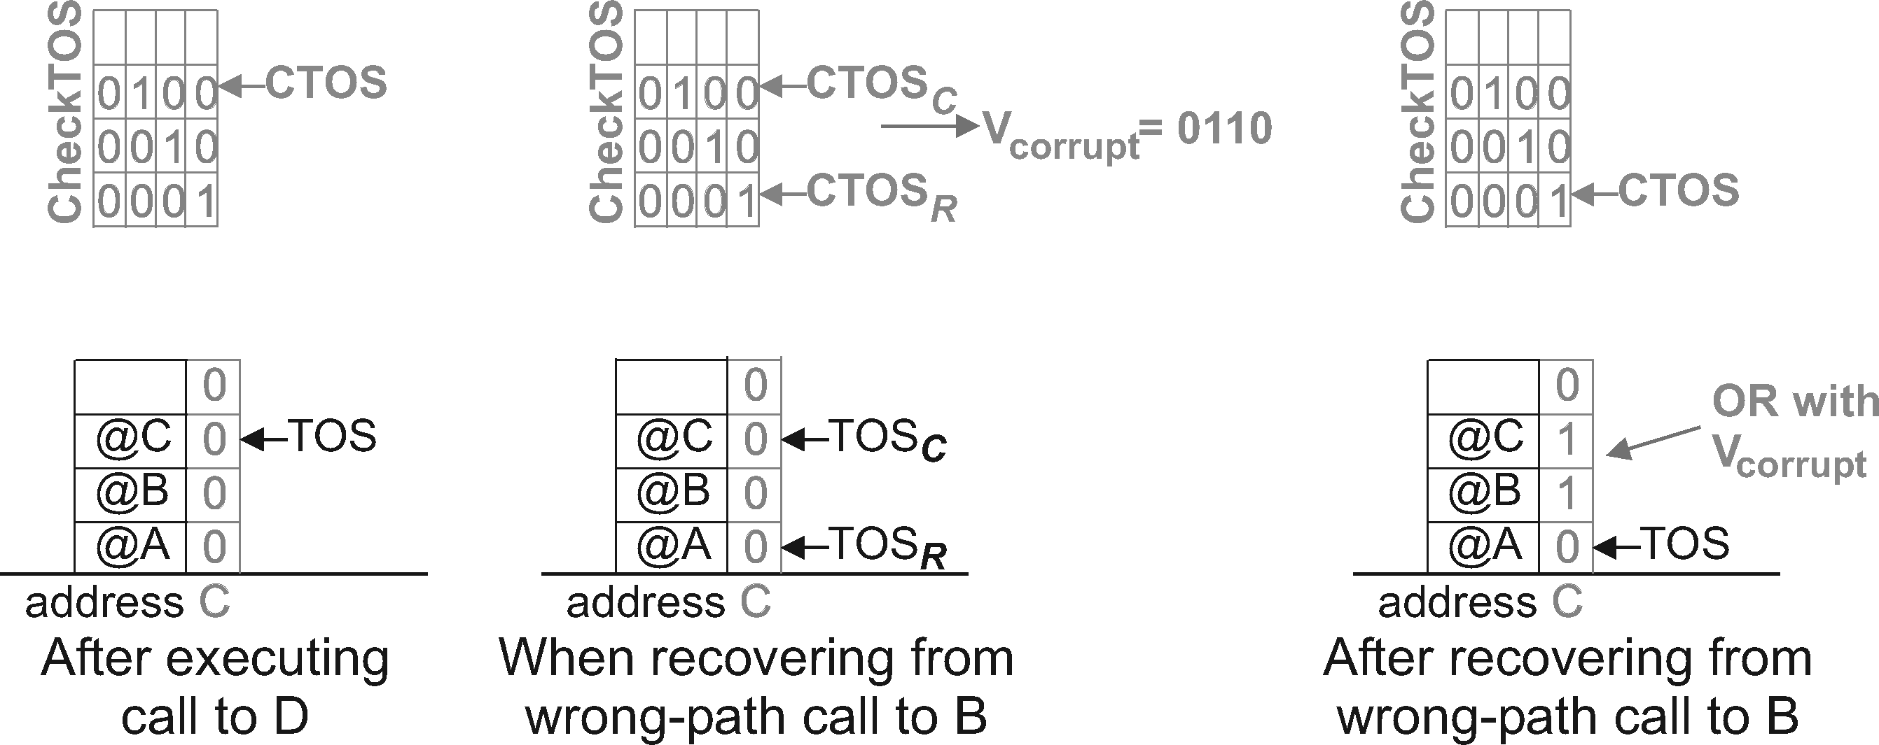
CT-RAS Recovery
Wrong Path
ORed
Simple RAS with extra local check point mechanism(CheckTOS).
Every entry in the RAS is augmented with a corruption bit.
When Corruption is detected, every bits between Current CTOS (CTOSc) and Recover CTOS (CTOSr) is Ored.
The ORed value (corrupt Vector) will be updated to every corruption bits.

Slide 14
SD-RAS PUSH
NEXT
TOS
NEXT
TOS
NEXT
TOS
TOS
NEXT
Self Detection RAS is proposed by Jourdan et al.
The SC-RAS explicitly links each RAS entry to the logically lower RAS entry using a next-on-stack (NOS).
The next entry to allocate is indicated by the NEXT pointer.

Slide 15
SD-RAS POP
By tracking the NOS, SC-RAS Pops its Prediction.
When RAS Pop, NEXT will be not decremented.
NEXT
TOS

Slide 16
SD-RAS Advantage
Call
Conditional Call (Predict miss)
Return
Return
Call
(Detect Predict miss)
Return
Wrong path Corruption is not covered in Simple RAS.
When a misprediction is detected, the call instruction may be squashed, leaving the wrong return target on the RAS.
TOS
TOS
TOS
TOS
TOS
TOS
Recovery But miss Predict

Slide 17
SD-RAS Advantage
Call
Conditional Call (Predict miss)
Return
Return
Call
(Detect Predict miss)
Return
Wrong path Corruption is covered in SD-RAS.
The Correct Path is leaved in the SD-RAS when Recovering.
NEXT
NEXT
NEXT
NEXT
TOS
TOS
TOS
TOS
TOS
NEXT
TOS
NEXT

Slide 18
SD-RAS Disadvantage
Call
Return
Call
Return
Call
Return
If same function called repeatedly, SD-RAS can be overwritten with the same value.
SD-RAS can be overflowed more frequently.
NEXT
TOS
NEXT
TOS
TOS
NEXT
NEXT
TOS

Slide 19
SD-RAS With Empty bit
E=1
Empty bit
E=0
NEXT
NEXT
TOS
TOS
To support the corruption detector, empty bit to the SC-RAS is added.
Initially set to 1.
When Pushed, set to 0.

Slide 20
SD-RAS With Empty bit
E=0
E=0
E=0
E=0
TOS
TOS
NEXT
NEXT
TOS
NEXT
NEXT
TOS
E=1
When RAS Pop and no more valid entry, set to 1.
When empty bit is set, the RAS is not popped since there are no more valid entries in the RAS.
NEXT
TOS

Slide 21
SD-RAS with MAX
Call
Conditional Call (Predict miss)
Return
Return
Call
(Detect Predict miss)
Return
The NEXT pointer is recovered from checkpoint storage when detecting a misprediction, so the corruption of these entries can not be deduced from the stack pointers (Add a MAX pointer).
MAX tracks the maximum value of the NEXT pointer.
NEXT, MAX
NEXT, MAX
NEXT, MAX
TOS
TOS
TOS
NEXT, MAX
TOS
Valid [MAX-N, NEXT]
NEXT
TOS
TOS
NEXT, MAX
MAX

Slide 22
Evaluation on Paper
The SC-RAS only suffers from overflow mispredictions.
Simple RAS and CT-RAS are suffer from wrong-path and overflows.
When RAS size is small(4~) CT-RAS is the most effective design.
SC-RAS is not effective because of RAS Overflow.
When RAS size is big (~128) SC-RAS design is the most effective design.
Because of wrong-path recovery, SC-RAS can be powerful.

Slide 23
The End

