Slide 1
Security Enhanced Big Data Processing for Defense Applications
Prof. Taeweon Suh
Computer Science and Engineering
Korea University
November 26, 2015

Slide 2
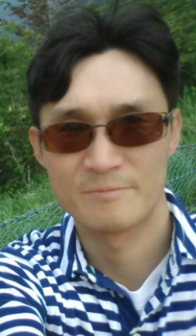
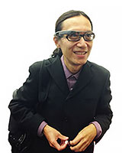
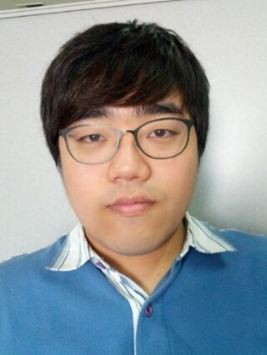
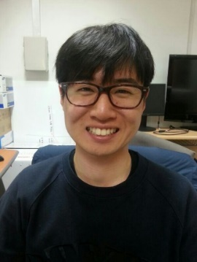
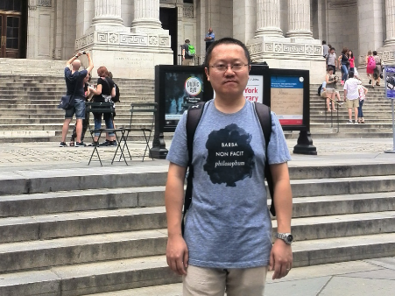
Project Background
NATO SPS (Science for Peace and Security) Program
Joint Research between a NATO country and a NATO partner country
Research collaboration between Korea University and University of Houston
Prof. Taeweon Suh from KU
South Korea: NATO partner country
Prof. Weidong Larry Shi from UH
USA: NATO Country
Project started 3 months ago from Sep. 2015

Slide 3
Big Data
Too Large, Complex and Dynamic
Yottabytes
Zettabytes
Exabytes
Petabytes
Terabytes
Gigabytes
Megabytes
source: http://ko.hortonworks.com/blog/big-data-defined-part-deux-value-definition/
source: http://www.theneweconomy.com/strategy/ big-data-is-not-without-its-problems
Notes:
What is Big data?

Slide 4
Big Data Processing Engines
MapReduce is one of the most widely used programming models

Slide 5
Success Stories in Big Data Processing
Commercial Applications
Beverage
On Sale!
Fruit
On Sale!
AACE Advanced Analytics & Campaign Enhancement
Notes:
AMORE PACIFIC and TESCO
아모레 퍼시픽은 AACE (advanced analytics and campaign enhancement) 프로젝트를 통해서 고객의 행동 패턴 50가지로 분류하여 (예시, 마일리지의 90%를 소진한 고객은 휴면으로 갈 확률이 일반 고객보다 3.5배 높다.) 맞춤 서비스를 개발, 고객 맞춤 서비스를 제공 하였다.
테스코 클럽카드
테스코는 클럽 카드를 배분하여, 매주 1500만건이 넘는 거래 데이터를 분석하여 식품 구매 성향에 따른 20개의 특성군을 생성. 맞춤형 광고 및 매장제품 배치를 시행하였다.
영국 3위에서 세계 3위로 성장.

Slide 6
Defense Applications
Detect potential threats with Big Data Processing
Secure-processing would be much more important
Phone-tapping
Security Camera
Process Big Data and
Filter out potential threats
Traditional Approaches
New Approach in Big Data Era
Notes:
Security with Traditional method + Security with Big Data processing

Slide 7
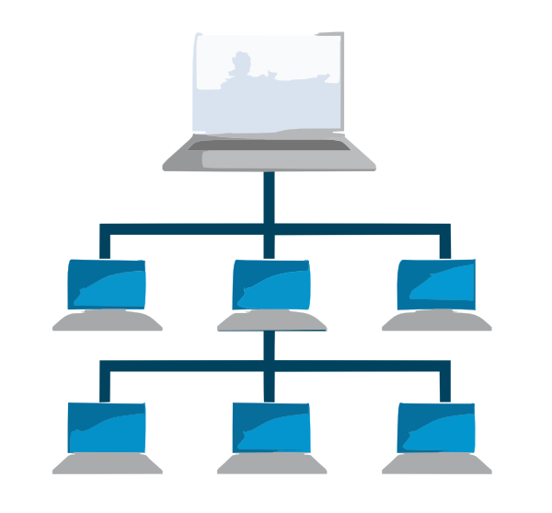
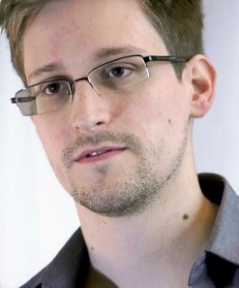
Potential Threats in Big Data Processing
Rogue Users
Reside in the same infrastructure
May break the boundaries between different execution environments and harm the security-sensitive data
Malicious Administrators
Intentionally reveal secret information of users or system
Edward Snowden
Notes:
1. Break System
2. Steal information
3. Modify data
Edward Joseph Snowden (born June 21, 1983) is a computer professional, former CIA employee, and former government contractor who copied classified information from the United States National Security Agency (NSA) and United Kingdom Government Communications Headquarters (GCHQ) for public disclosure in 2013. The information revealed numerous global surveillance programs, many run by the NSA and Five Eyes with the cooperation of telecommunication companies and European governments.
On May 20, 2013, Snowden flew to Hong Kong after leaving his job at an NSA facility in Hawaii and in early June he gave thousands of classified NSA and GCHQ documents to journalists Glenn Greenwald, Laura Poitras and Ewen MacAskill. Snowden came to international attention after stories based on the material appeared in The Guardian and The Washington Post. Further disclosures were made by other newspapers including Der Spiegel and The New York Times.

Slide 8
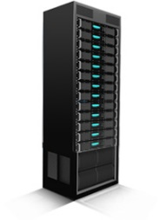
Traditional Processing
Users
Encrypt data
Cloud
Decrypt and process data
Cons
Malicious insider
Plain-text leakage
Encryption key leakage problem
User
Encrypted Data
Cloud
Master
Node
Encrypted Result
Sensitive Data
Result
Slave Node (x86)
Symmetric Key

Slide 9
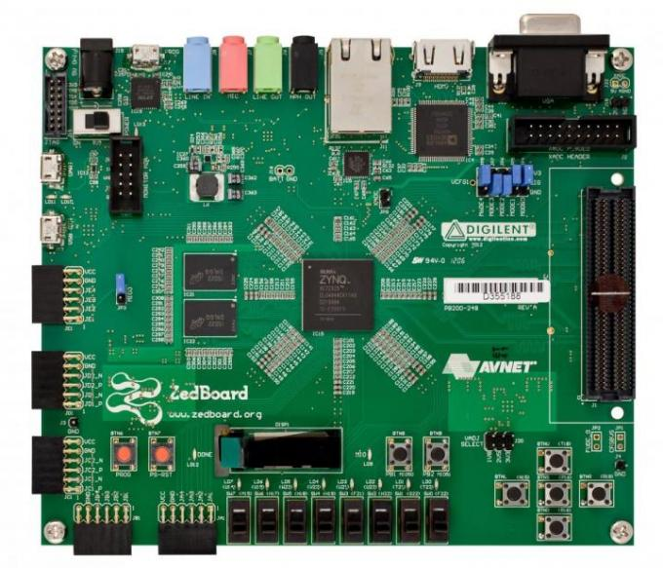
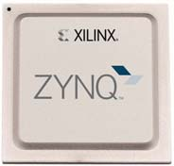
Research Approach Overview
Make no one touch the data
Process the security-sensitive tasks inside hardware
Use FPGA (Field Programmable Gate Array)
Bitsteam (MapReduce hardware version) is temper-resistant
User’s key is not exposed
Data is not exposed
Xilinx’s SoC FPGA
(Zynq)
Altera’s SoC FPGA
(Stratix)
Xilinx’s Zynq based System

Slide 10
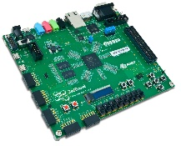
Research Approach
User
Encrypt data with symmetric key
Encrypt symmetric key with cloud’s public key
Cloud
Scheduling for application
SoC FPGA
Decrypt and process data on FPGA
Encrypted Data and Key
Cloud
User
Master
Node
Encrypted Result
Sensitive Data
Sensitive Data
Application
Result
Slave Node (SoC FPGA)
Symmetric Key
SoC FPGA Public Key Encryption
SoC FPGA Private Key Decryption

Slide 11
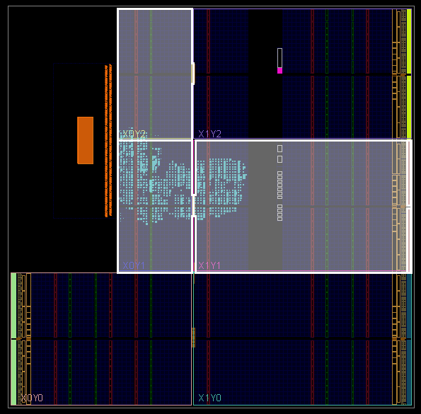
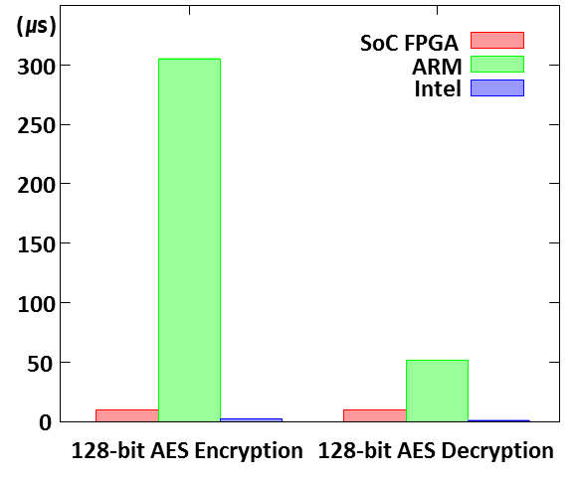
Current Status
Successfully ported MapReduce applications onto SoC FPGA
DNA Sequencing & K-means applications
Comparison of Cryptography module on different platform
Zynq SoC FPGA vs Cortex-A9 (ARMv7) vs Intel Core i7 with AES

Slide 12
Research Directions & Challenges
Design and validate an FPGA-based server farm
Port Hadoop on the FPGA farm
Accelerate MapReduce processing via eliminating shuffle barriers
Automate MapReduce hardware porting to FPGA depending on applications
Optimize FPGA resource utilization
…

Slide 13
Q & A

Slide 14
Terminologies
Symmetric Encryption
Same key for both encryption and decryption
Faster than Asymmetric Encryption
Asymmetric Encryption
Different key for encryption and decryption
Public key
Used for encryption
Can be shared with anyone
Private key
Used for decryption
Need to be kept secret
SoC FPGA (or Programmable SoC)
CPU + FPGA
FPGA (Hardware) can be dynamically configured

Slide 15
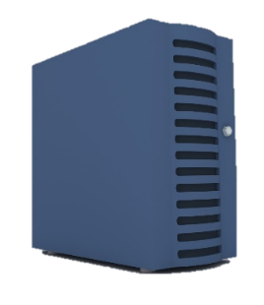
Proposed Solution #2
Proxy Re-encryption Based Solution
User A
Proxy
User B
User A Public Key Encryption
User A Private Key Decryption
User B Public Key Encryption
User B Private Key Decryption

Slide 16
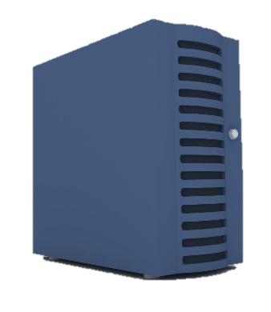
Proposed Solution #2
Sensitive Data
1. Encrypted Data
Cloud
User
Symmetric Key
Master
Node
5. Encrypted Result
3. Re-encryption Key Generation
Proxy
4. Re-encrypted Key
Symmetric Key
Application
Result
2. Data Key Request
Symmetric Key
Slave Node (Programmable SoC)
Symmetric Key Encryption
User Public Key Encryption
User Private Key Decryption
SoC Public Key Encryption
SoC Private Key Decryption

Slide 17
Current Status of Research
H/W Based Secure MapReduce Framework Acceleration and Resource Optimization
Separate barrier on H/W
Mapper
Mapper
…
Mapper
Mapper
Shuffle Barrier
Separate Barrier
Separate Barrier
Reducer
…
Reducer
Notes:
Colored boundary means FPGA execution boundary

Slide 18
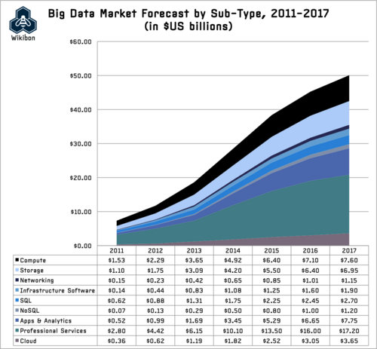
Big Data Market Size
source: http://wikibon.org/wiki/v/Big_Data_Vendor_Revenue_and_Market_Forecast_2013-2017

Slide 19
Military Application
Critical Decision Making in Battlefield

